Slide 1
Branding

Slide 2
1.Objectives & Goals
At the end of this module you will be able to:
Understand the meaning of the brand for the business entity
Theoretical basis
Create a brand as a sales tool („brand sells“)
Apply the theoretical basis to practical exercises
Activities related to maintaining the brand
Promotion, questionnaires, public response, constant brand building

Slide 3
Index
Unit1
Unit2
Unit3
Unit4
Introduction
Entry analysis
Competition analysis
Logo creation

Slide 4
Index
Unit5
Unit6
Unit7
Identity creation
Presentation to customer
Finalization

Slide 5
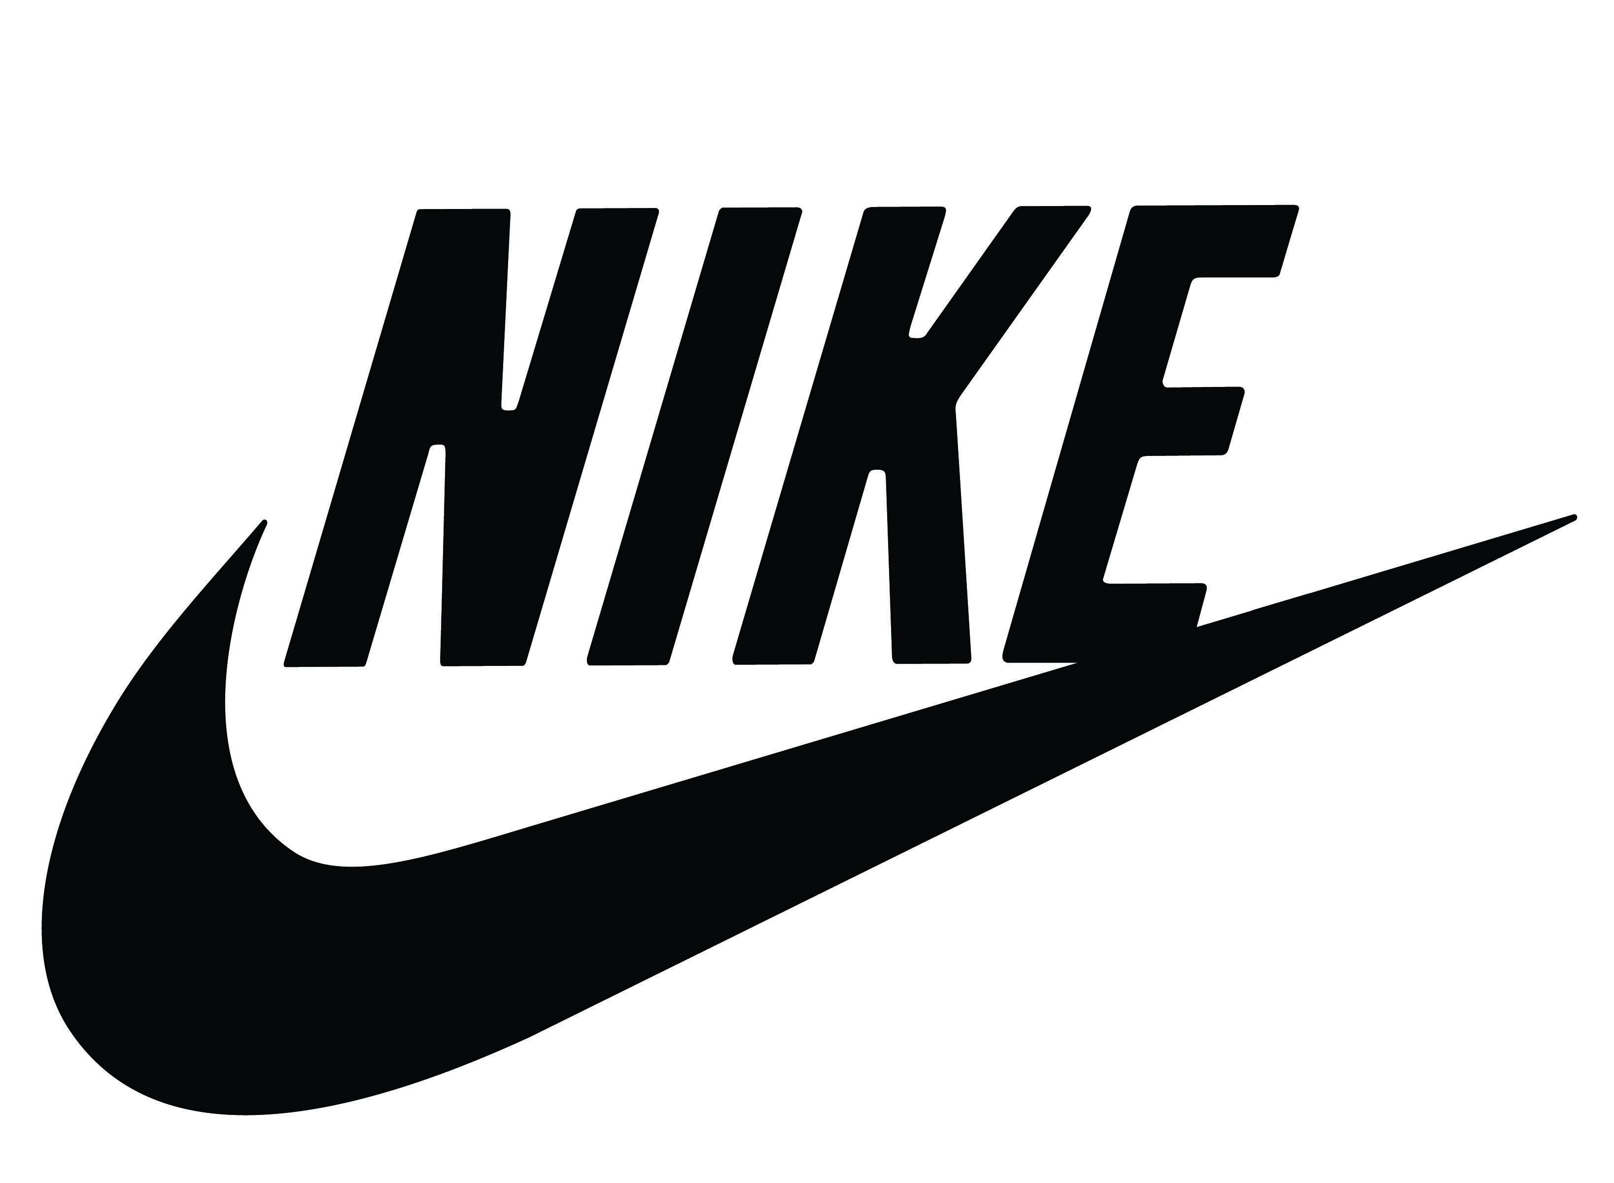
1. Introduction
Branding:
process of creating, spreading and building a brand.
way and what the brand communicates.
value, quality and image of the brand in the minds of your potential customers
Figuratively speaking, if the factory where you make products burns out, the only thing left for you to save is the strength of your brand.
Branding is the process of giving a meaning to specific organization, company, products or services by creating and shaping a brand in consumers’ minds. It is a strategy designed by organizations to help people to quickly identify and experience their brand, and give them a reason to choose their products over the competition’s, by clarifying what this particular brand is and is not.

Slide 6
2. Entry analysis
Branding Strategy - helps you clearly identify your brand- what it embodies, offers, and looks like and it helps establish a unique brand voice, personality, and brand identity which helps you to reach your specific, target audience in meaningful ways
Briefing - overview of exactly what your brand is, and isn't. Brand brief should include:
1. Vision Statement- The long and short term objectives for your brand.
2. Mission Statement - An overview of how you intend to achieve your vision.
3. Brand Promise - The solutions, and expectations you communicate to customers and prospects.
4. Brand Values - The core value you base your brand around. Integrity, quality, and eco- friendliness are just some examples.
5. Target Audience - Who you want to serve.
6. Brand-Positioning/USP - The reason why customers should choose your brand over others.
7. Key competitors - The brands most likely to win over your customers. Even if they aren't direct competitors.
8. Competitive Advantage - Conditions or circumstances that allow your brand to offer better or cheaper solutions.
9. Brand Voice - Your brand's style of communication. The words, lingo, vibe (fun, personable, humourous...)
10. Brand Culture - The principles, code of conduct, and work ethics in the internal environment.

Slide 7
2. Entry analysis
Understanding of the brand - Brands are different from products in a way that brands are “what the consumers buy”, while products are “what concern/companies make”. It is an accumulation of emotional and functional associations. Brand is a promise that the product will perform as per customer’s expectations. It shapes expectations of customers about the product. They usually have a trademark which protects them from use by others. A brand gives particular information about the organization, good or service, differentiating it from others in marketplace. Brand carries an assurance about the characteristics that make the product or service unique. A strong brand is a means of making people aware of what the company represents and what are it’s offerings.
Business model – is a framework for finding a systematic way to unlock long- term value for an organization while delivering value to customers and capturing value through monetization strategies. A business model is a holistic framework to understand design, and test your business assumptions in the marketplace.

Slide 8
3. Competition analysis
1. Your target audience and your competitors - before creation a business brand you need to understand the current market, i.e., who your potential customers and current competitors are.
There are few ways to do this step :
- Google your product or service category and analyze the direct and indirect competitors that come up.
- Check subreddits that relate to your customers and eavesdrop on their conversations and product recommendations.
- Talk to people who are part of your target market and ask them what brands they buy from in your space.
- Look at the relevant social media accounts or pages your target audience follows and are receptive to.
- Go shopping online or offline and get a feel for how your customers would browse and buy products.
As you go about your research, make a note of:
- Who your “lowest hanging fruit” customers are—the ones you could most easily sell to.
- Who your top-of-mind competitors are—the brands that are established and known in the market.
- How your customers speak and what they talk about—the interests they have and the language they express them in.
2. Theoretical basis of competition analysis – resources of gained datas
3. Determination of direct competition, as well as competition between suppliers.

Slide 9
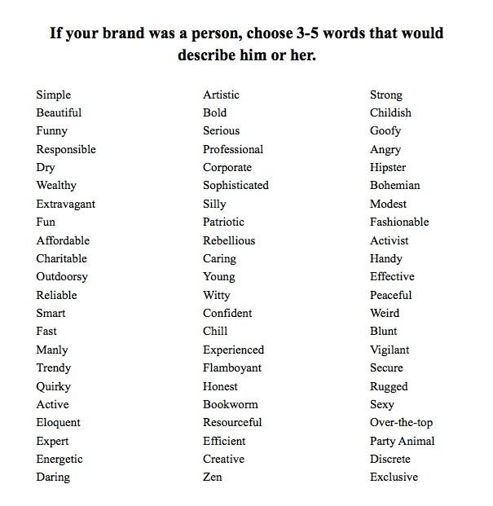
Pick your focus and personality - You can’t ​​establish your brand to be everything to everyone, especially at the start.
It’s important to find your focus and let that inform all the other parts of your brand as you build it.
You need to know first:
1. What’s your positioning statementi? one or two lines that stake your claim in the market. This isn’t something you put on your website or business card it’s just to help you answer the right questions about your brand and aids in creating your brand’s tagline. Your positioning statement should go something like...
We offer [PRODUCT/SERVICE] for [TARGET MARKET] to [VALUE PROPOSITION].
Unlike [THE ALTERNATIVE], we [KEY DIFFERENTIATOR].
For example: We offer water bottles for hikers to stay hydrated, while reducing their carbon footprint. Unlike other water bottle brands, we plant a tree for every bottle you buy.
4.Logo creation

Slide 10
2. What words would you associate with your brand? imagine your brand as a person. What would he or she be like? What kind of personality would your customers be attracted to? This will help inform your voice on social media and the tone of all your creative, both visual and written. For example how to create a new brand is pitching three to five adjectives that describe the type of brand that might resonate with your audience.
3. What metaphors or concepts describe your brand? thinking about your brand identity as a metaphor, or personifying it, can help you identify the individual qualities you want it to have. This can be a vehicle, an animal, a celebrity, a sports team, anything—as long as it has a prominent reputation in your mind that summons the sort of vibe you want your brand to give off. For example, if you want to establish your brand targeting entrepreneurs, you might choose to use the raccoon as a starting point: They’re scrappy survivors who will do anything to thrive. If your brand identity was an animal, what animal would it be and why is it like that animal to you?
4.Logo creation

Slide 11
Choose your business name - “A rose by any other name would still smell as sweet. But Nike by another name would be seen on fewer feet.” Shakespeare (sort of)
Personality, actions, and reputation of your brand identity are really what give the name meaning in the market. So your company’s name is probably one of the first big commitments you have to make. It’ll impact your brand logo, your domain, your marketing, and your trademark registration, if you decide to go that route (it’s harder to trademark generic brand names that literally describe what you sell). Ideally, you want a store name that’s hard to imitate and even harder to confuse with existing players in the market. You can use our business name generator to brainstorm some names, or try one (or a combination) of the following approaches:
Make up a word, like Pepsi.
Reframe an unrelated word, like Apple for computers.
Use a suggestive word or metaphor, like Buffer.
Describe it literally (caution: easy to imitate),like The Shoe Company.
Alter a word by removing letters, adding letters, or using Latin endings, likeTumblr (Tumbler) or Activia.
Create an acronym from a longer name,like HBO (Home Box Office).
Combine two words: Pinterest (pin + interest) or Snapple (snappy + apple)
4.Logo creation

Slide 12
4.Logo creation
Write your slogan - A catchy slogan is a nice-to-have asset—something brief and descriptive you can use as a tagline in your social media bios, website header, custom business cards, and anywhere else where you’ve got very few words to make a big impact.
Keep in mind that you can always change your slogan as you find new angles for marketing— Pepsi has gone through over 30 slogans in the past few decades.
A good slogan is short, catchy, and makes a strong impression to boost ​​brand awareness. Here are some ways to approach writing a slogan of your own:
Stake your claim. Death Wish Coffee: “The World’s Strongest Coffee”
Make it a Metaphor. Redbull: “Redbull gives you wings.”
Adopt your customers’ attitude. Nike: “Just do it.”
Leverage labels. Cards Against Humanity: “A party game for horrible people.”
Write a rhyme. Folgers Coffee: “The best part of waking up is Folgers in your cup.”
Describe it literally. Aritzia: “Women’s fashion boutique.”
Try slogan maker to brainstorm some ideas, or play off of your positioning statement to generate potential one-liners to describe your business.

Slide 13
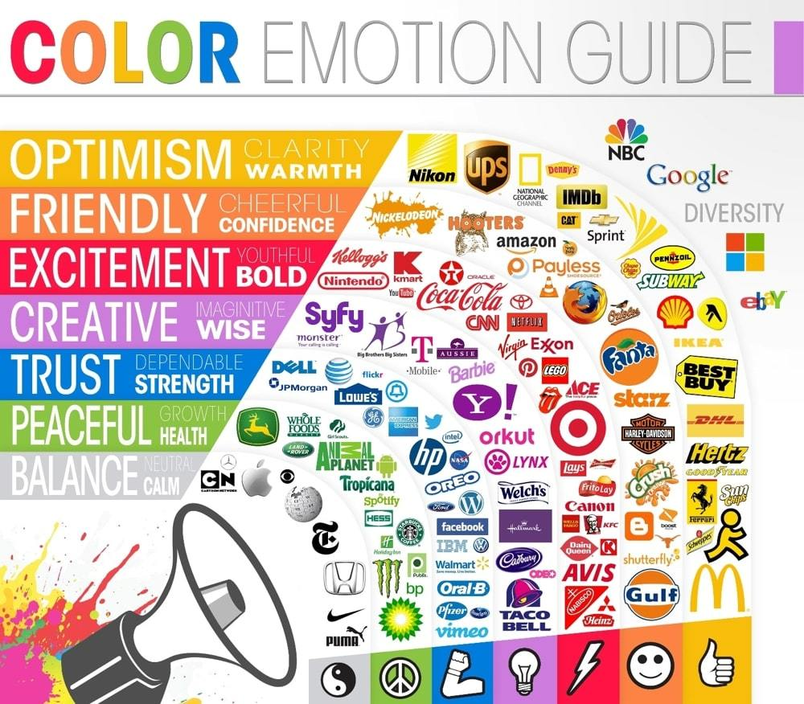
4.Logo creation
Practically use the obtained information about the company,
Choose the look of your brand (colors and font) - Once you’ve got a name down, you’ll need to think about your brand design—how you’ll visually
represent your brand—namely your colors and typography.
This will come in handy when you start to make your own website.
Choosing your colors
Colors don’t just define the look of your brand, they also convey the feeling you want to communicate and help you make it consistent
across everything you do. You'll want to choose colors that differentiate you from direct competitors to avoid confusing consumers.
Color psychology isn’t an exact science, but it does help to inform the choices you make, especially when it comes to the color you pick for your brand logo.
This infographic offers a nice overview of the emotions and associations that different colors generally evoke.

Slide 14
4.Logo creation
Choosing your fonts
keep it simple. Pick two fonts at most to avoid confusing visitors: one for headings and one for body text (this doesn’t include the font you might use in your brand logo). You can use Font Pair to browse from a wide selection of fonts that go well together.
design your brand logo (find logo creation software). It’s the face of your company after all
Ideally, you’ll want to create your brand with a logo that’s unique, identifiable, and scalable to work at all sizes (something often overlooked).
Consider all the places where your brand’s logo needs to exist,
If you have a text logo as your Instagram avatar, for example, it’ll be almost impossible to read. To make your life easier, create a square version of your brand logo with an icon element that remains recognizable even at smaller sizes.
apply across your business - Applying your branding across your business gives it a cohesive brand story. A brand story represents who your business is and what it stands for. It sets the stage for every interaction customers have with your brand, in-store and online.

Slide 15
5. Identity creation
so that customers know the brand among the competition.
Brand identity stems from an organization, i.e., an organization is responsible for creating a distinguished product with unique characteristics. It is how an organization seeks to identify itself. It represents how an organization wants to be perceived in the market. An organization communicates its identity to the consumers through its branding and marketing strategies. A brand is unique due to its identity. Brand identity includes following elements - Brand vision, brand culture, positioning, personality, relationships, and presentations. Brand identity is a bundle of mental and functional associations with the brand. Associations are not “reasons-to-buy” but provide familiarity and differentiation that’s not replicable getting it. These associations can include signature tune(for example - Britannia “ting-ting-ta-ding”), trademark colours (for example - Blue colour with Pepsi), logo (for example - Nike), tagline (for example - Apple’s tagline is “Think different”),etc.
Brand identity is the total proposal/promise that an organization makes to consumers. The brand can be perceived as a product, a personality, a set of values, and a position it occupies in consumer’s minds. Brand identity is all that an organization wants the brand to be considered as. It is a feature linked with a specific company, product, service or individual. It is a way of externally expressing a brand to the world.

Slide 16
5. Identity creation
Brand identity is the noticeable elements of a brand (for instance - Trademark colour, logo, name, symbol) that identify and differentiates a brand in target audience mind. It is a crucial means to grow your company’s brand.
Brand identity is the aggregation of what all you (i.e. an organization) do. It is an organizations mission, personality, promise to the consumers and competitive advantages. It includes the thinking, feelings and expectations of the target market/consumers. It is a means of identifying and distinguishing an organization from another. An organization having unique brand identity have improved brand awareness, motivated team of employees who feel proud working in a well branded organization, active buyers, and corporate style. Brand identity leads to brand loyalty, brand preference, high credibility, good prices and good financial returns. It helps the organization to express to the customers and the target market the kind of organization it is. It assures the customers again that you are who you say you are. It establishes an immediate connection between the organization and consumers. Brand identity should be sustainable. It is crucial so that the consumers instantly correlate with your product/service.
Brand identity should be futuristic, i.e, it should reveal the associations aspired for the brand. It should reflect the durable qualities of a brand. Brand identity is a basic means of consumer recognition and represents the brand’s distinction from it’s competitors.

Slide 17
6. Presentation to „client“
1. Start with the logo design brief
The success of your logo presentation to a client starts long before you sit down to present your logo.
The real secret of how to present a logo begins in your initial meetings with clients when you agree on a creative brief. Then, presenting a logo to a client becomes a matter of showing them how your design fulfills the requirements you both agreed on earlier in the process. Here’s what a few expert logo designers had to say about how to present a logo according to the design brief:.
2. Make the logo presentation in-person or via video
Another suggestion on how to present a logo that came up over and over again in our group of experts was to make your logo presentations to clients in-person (or online), not via email.
Part of mastering how to present a logo is being able to gauge client reactions on the fly and adapt to a wide variety of responses. This proves near impossible when you simply present a logo via email.
Taking time to prepare a logo presentation that you make “in person” also shows you care about how you present the logo and that you believe in your final logo design.
3. Tell a compelling story about the logo
Learning how to present a logo to a client is as much about storytelling as it is about professional presenting skills. In fact, a story will often get you much further with a client than a stiff, executive-style presentation ever will. Your story should present the problem the company or its customers have faced and how the new logo solves many previous issues.

Slide 18
6. Presentation to „client“
4. Include mockups & provide context
In addition to telling a story and showing how your logo solves the client’s problem-at-hand, you’ll also want to learn how to present a logo in context by providing real-life scenarios and mock-ups. By presenting a client’s logo in real-world settings (like on their products, on business stationary, or in advertisements), your client will be more likely to envision the strength of the new logo you’re presenting.
5. Show off the logo’s versatility
In addition to presenting mockups of the logo’s potential usage, it will be helpful to show how versatile your logo can be. Learning how to present a logo in a wide variety of ways will help your client see how flexible and timeless your new design is. It will help them see exactly why you charge good money for logo creation?
6. Focus on the audience
The audience is often not the client you’re presenting the logo to, but their customers or clients. So while it may be tempting to talk about how much your client should like your new logo designs, learning how to present a logo with the right audience in mind is critical to your success. Perhaps one of the most critical pieces of advice was given by logo designer Ben Mottershead from Ben designs“Always show the logo as it would be seen by an audience.” That means as you’re presenting mockups or highlighting the versatility of your new logo design, make sure you highlight the new logo from the perspective of the most important audience: your client’s customer.

Slide 19
7. Finalization
The logo is the first thing that people will see as a symbol of your brand. It will depict what your brand is and will convey the primary thought of your brand. People do all sorts of creative stuff to make their brand logo better but all the efforts fail is some things are not considered. There are certain rules defined that brands need to follow while desidning the logo for their business. s. We drafted a list where we have listed 6 things to look before finalizing your brand’s logo.
Does your audience understand your logo well?- You might have designed a beautiful logo with all sorts of colors but it won’t make any sense if your audience doesn’t understand it or they misunderstand it with something else. The logo has to convey the real essence of your brand should be correctly perceived by the audience.
Make it simple yet beautiful- Adding too many shapes and contrasting colors will make the logo cluttered. Your audience might not like a logo with a really complex design. Keep it simple with fewer colors which will also make your audience to recognize it easily when they see the logo again. Eg- Apple’s logo is simple and conveys their idea of keeping things simple and beautiful.
Don’t use too many effects - Effects like shadows, bevels, patterns may seem very attractive but they may be a problem when viewed across various devices and formats. The logo may seem very different if you view it on your computer and you view it on a printed brochure if you use an effect.

Slide 20
7. Finalization
Don’t use the colors the way you like - Color combinations denote a meaning and are can’t be merely a choice of an individual. Some color combination denotes calmness and some denote energy. This theory can even be applied to shapes where a circle denotes infinity and a spark shape denotes energy.
Make Guidelines for your Logo - If you have taken efforts and creating the logo then make sure that it should be used properly. Define the guidelines as to where should the logo be used, with which proper color combination in CMYK or RGB, what changes can be made to the logo etc. They all needed to be listed properly to maintain the uniformity and the to justify the logo’s use.
Make it usable for different formats - Designing a logo that suits different formats ranging from as big as on a hoarding to as small as on a social media page is a must. It should have that same attraction irrespective of any kind of format.
Always remember Logo is not only a symbol of your brand but also is a symbol for you, it is important to love it. It is one of the few visible element of your business and will bring the company under a single umbrella.

Slide 21
Summing up
Unit 1
Introduction
Unit 7
Finalization
Unit 2
Entry analysis
Unit 6
Presentation to customer
Unit 3
Competition analysis
Unit 5
Identity creation
Unit 4
Logo creation

Slide 22
Self-assessment test
What is Branding?
What does not belong to entry analysis?
In which stage do we target competition and audience ?
Process of creating, spreading and building a brand
Branding strategy
Briefing
Write your slogan
Competition analysis
When do we pick our focus and personality ?
Identity creation shouldn´t be ?
How do we start with presentation to client?
Futuristic
Aggregation of all of you
Like a methaphore
When we create logo
Logo design brief

Slide 23
Interesting links
https://www.levosphere.sk/faq/co-je-branding/
https://www.lcca.org.uk/blog/education/history-of-branding/
https://www.dropbox.com/sh/a4l9k9mlzbr3pnd/AADozsSvc8cQ5xfpCnDbgTz1a?dl=0
https://www.thebrandingjournal.com/2015/10/what-is-branding-definition/

Slide 24
Resources
https://www.levosphere.sk/faq/co-je-branding/
https://www.lcca.org.uk/blog/education/history-of-branding/
https://en.99designs.pt/blog/design-history-movements/history-of-branding/
https://www.thebrandingjournal.com/2015/10/what-is-branding-definition/
https://www.udemy.com/course/branding-strategy-for-entrepreneurs-and-small-businesses/
https://www.ziflow.com/blog/brand-brief#What_is_a_Brand_Brief?
https://www.managementstudyguide.com/what-is-brand.htm
https://www.shopify.com/blog/how-to-build-a-brand
https://millo.co/tips-on-presenting-logos-to-a-client
https://www.systematixinfotech.com/6-things-look-finalizing-brand-logo/
https://www.columnfivemedia.com/how-to-create-a-brand-style-guide/

